Slide 1
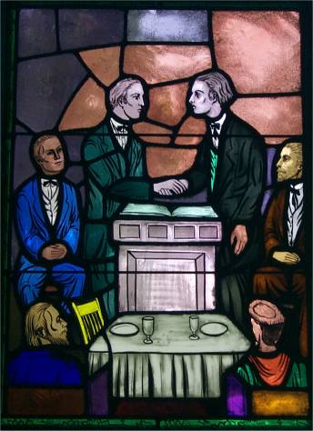
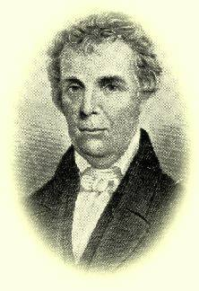
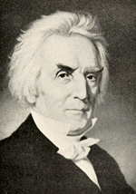
The Stone/Campbell Movement
Barton Warren Stone
Alexander Campbell

Slide 2
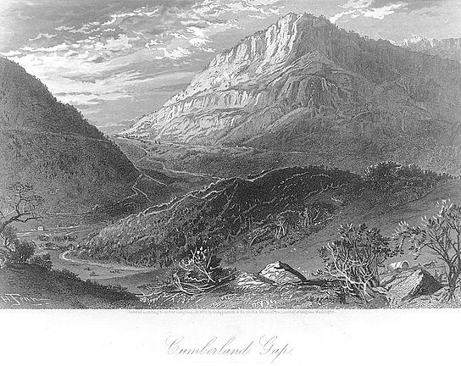
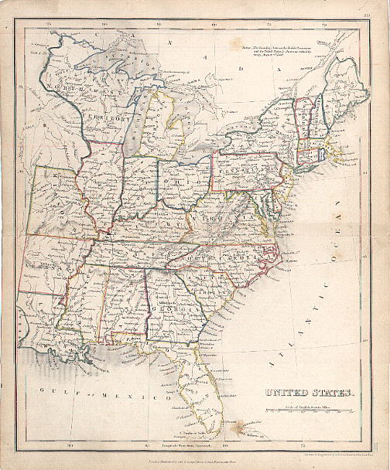
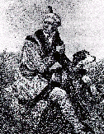
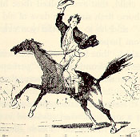
Early 19th Century America

Slide 3
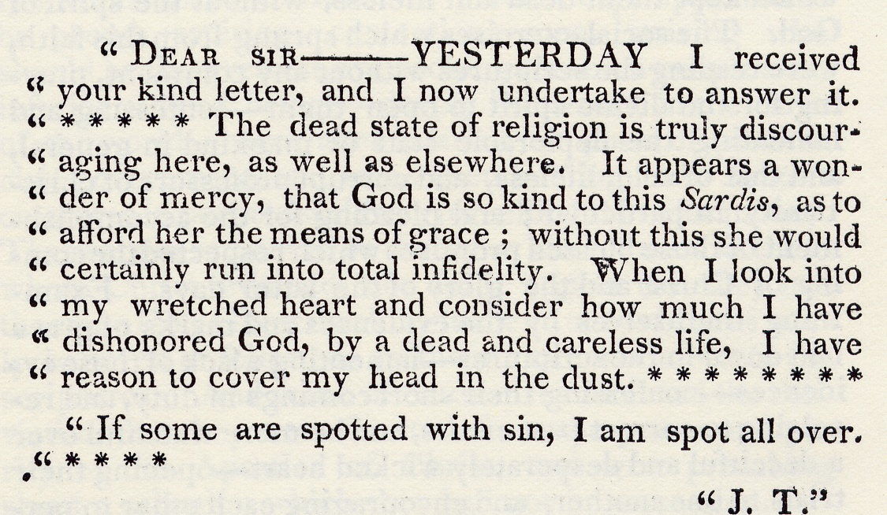
Background To The Kentucky Revival
“The Kentucky Revival” Richard McNemar, Chapter 1

Slide 4
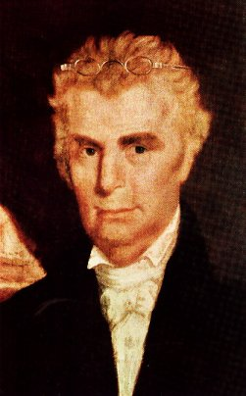
The Work And Influence Of Barton W. Stone In Kentucky

Slide 5
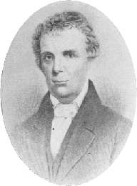
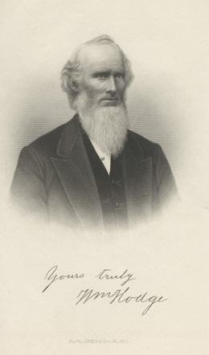
Barton
Warren
Stone
Born In 1772 – Port Tobacco, Maryland
Feb 1, 1790, Age 18, Attends Doctor David Caldwell’s Guilford Academy, Greensboro, NC
The Young Student
Gets Religion Under
The Preaching Of
William Hodge
1795 Spends A Year At
Hope Hull’s Academy
In Washington, Ga.
1796 – Ordained Orange
Presbytery, Henry Patillo
William Hodge

Slide 6
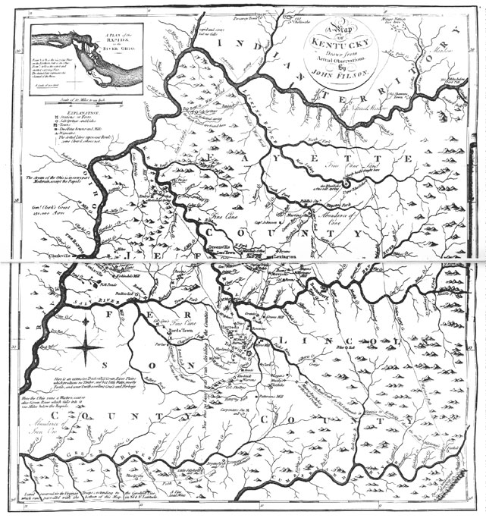
Barton
Warren
Stone
Stone Goes West To Kentucky

Slide 7
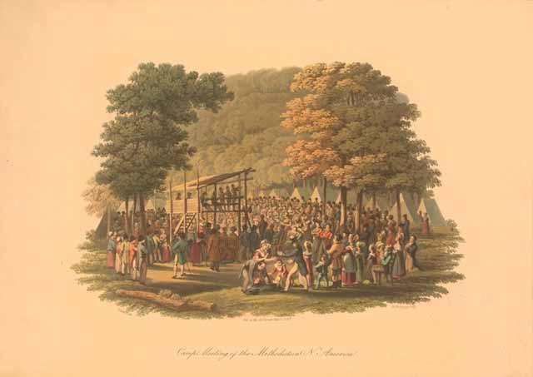
Getting Religion: Calvinism’s Influence On Late 18th & Early 19th Century Religion

Slide 8
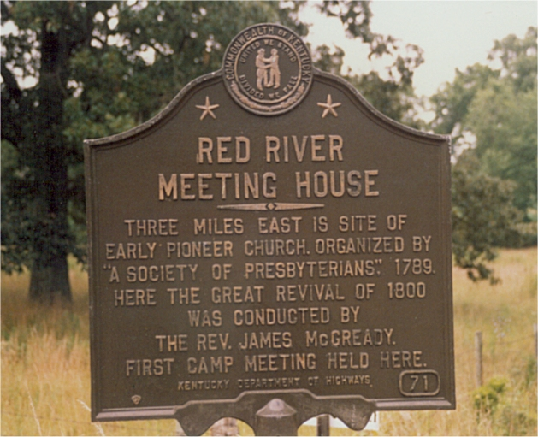
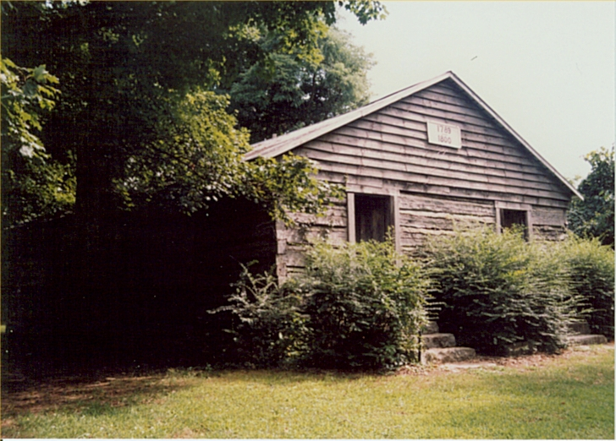
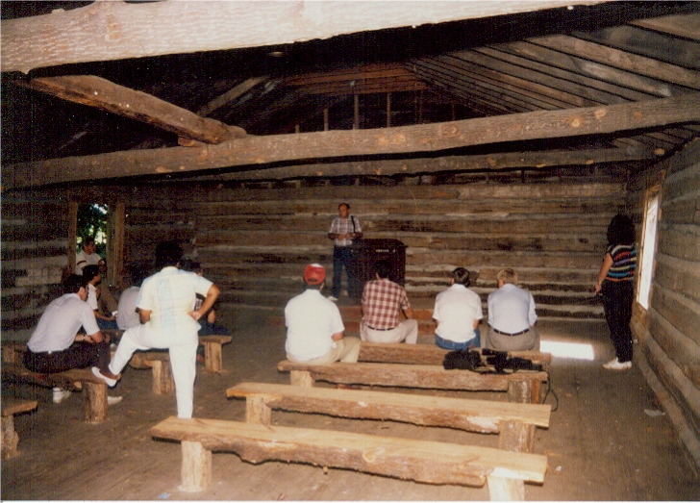
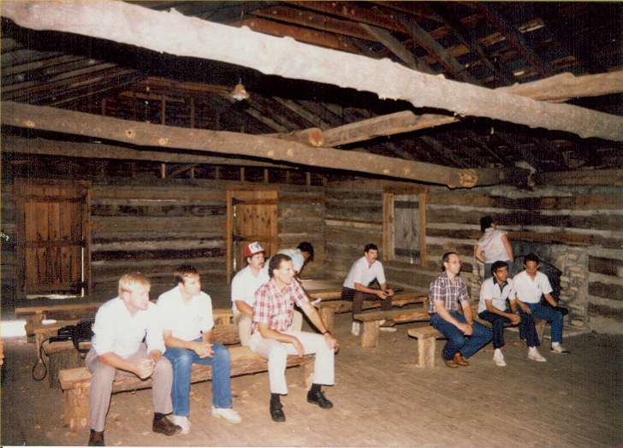
Red River Meetinghouse
Logan County, Kentucky
Birthplace Of The Kentucky Revival

Slide 9
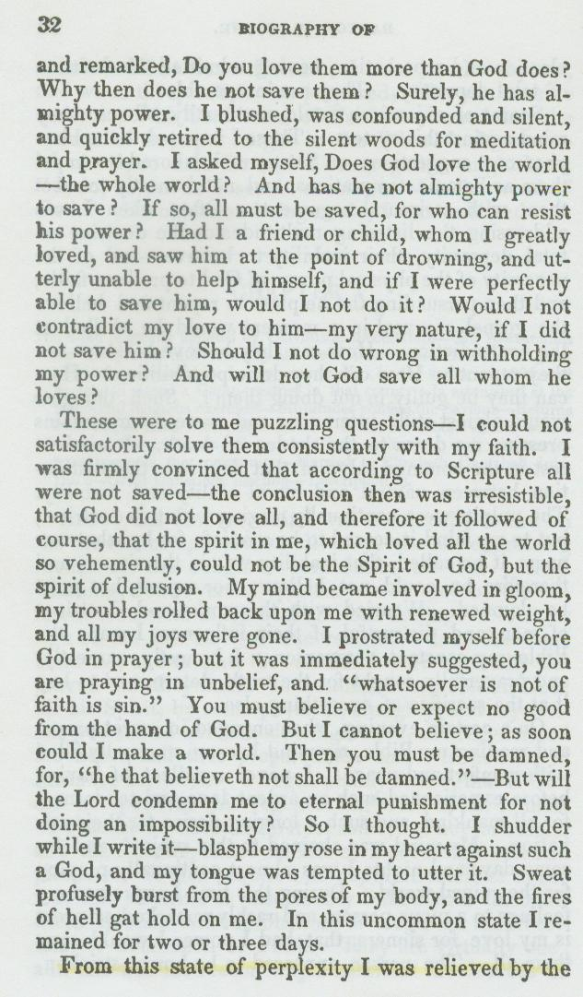
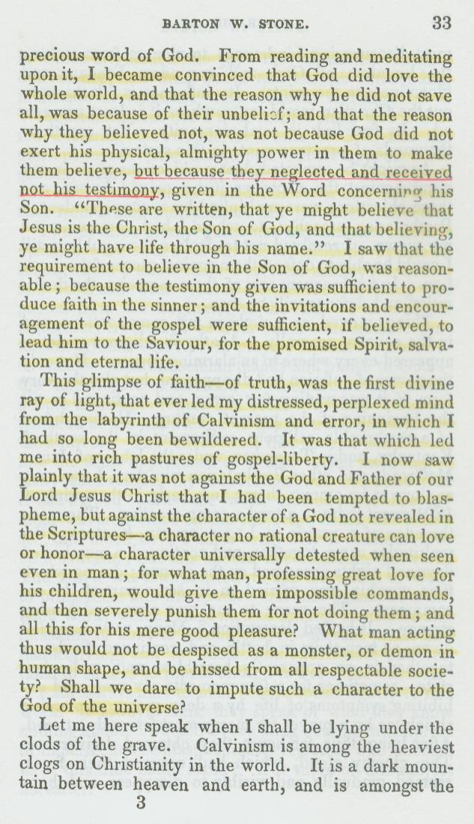
B.W. Stone Battle With Calvinism
Does
God
Really
Love
The
Whole
World
as is
said
in
John 3:16?
Continued On Next Slide

Slide 10

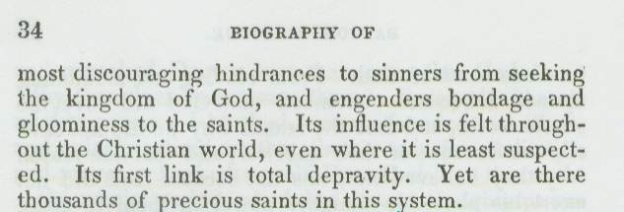
B.W. Stone Battle With Calvinism

Slide 11
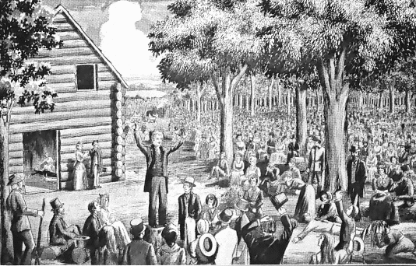
The Cane Ridge Revival
k

Slide 12
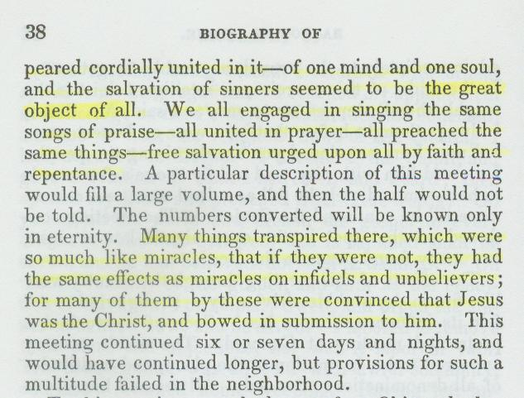
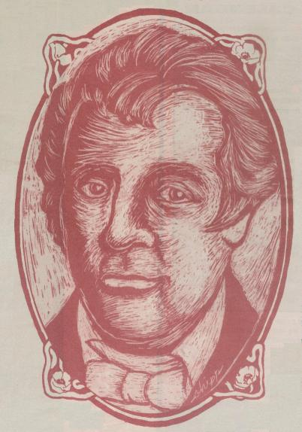
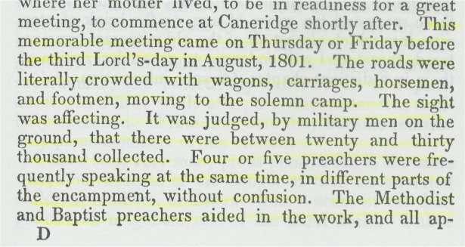
The Focus Of The Revival
Some Falsely Claim That The Focus Of The Cane Ridge Revival Was To Achieve A Religious Experience. See Stone’s Purpose In The Revival From His Autobiography

Slide 13
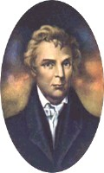
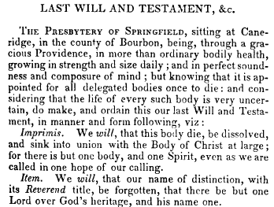
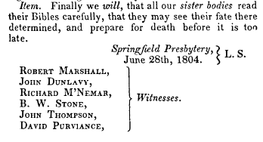
The Last Will & Testament Of The Springfield Presbytery, June 28, 1804

Slide 14
Resolutions from The Last Will Of The Springfield Presbytery
A Call To Take The Bible As The Only Sure Guide to Heaven
A Call To Reject The Westminster Confession Of Faith And All Document Designed By Man
That The church of Christ Resume Her native Right Of Internal Government
That The Title Of “Reverend” Be Forgotten, And Designated Only For The Lord.
At The Insistence Of Rice Haggard, The Name “Christian” Only Be Used
Notes:
The Last Will And Testimony Of The Springfield Presbytery
"THE PRESBYTERY OF SPRINGFIELD, sitting at Cane Ridge, in the county of Bourbon. Being, through a gracious providence, in more than ordinary bodily health, growing in strength and size daily; and in perfect soundness and composure of mind; but knowing that it is appointed for all delegated bodies once to die: and considering that the life of every such body is very uncertain, do make, and ordain this our last Will and Testament, in manner and following, viz:
Imprimis. We will, that this body die, be dissolved, and sink into union with the body of Christ at large, for there is but one body, and one spirit, even as we are called in one hope of our calling.
Item. We will, that our name of distinction, with its Reverend title, be forgotten, that there is but one Lord over God’s heritage and His name one.
Item. We will, that our power of making laws for the government of the church and executing them by delegated authority forever cease; that the people may have free course to the Bible, and adopt the law of the spirit of life in Christ Jesus.
Item. We will, that candidates for the Gospel ministry henceforth study the Holy Scriptures with fervent prayer, and obtain license from God to preach the simple Gospel, with the Holy Ghost sent down from Heaven, without any mixture of Philosophy, vein deceit, traditions of men or rudiments of the world- and let none henceforth take this honor to himself but he that is called of God, as was Aaron.
Item. We will, that the church of Christ resume her native right of internal government—try her candidates for the ministry as to the soundness of their faith, acquaintance with experimental religion, gravity, and aptness to teach; and admit no other proof of their authority but Christ speaking in them- We will, that the church of Christ lock to the Lord of the harvest to send forth laborers into His harvest; and she resume her primitive right of trying those who say they are apostles and are not.
Item. We will, that cacti particular church, ass body, actuated by the same spirit, choose their own preacher, and support him with a free will offering without a written call or subscription--admit members—remove offenses; and never henceforth delegate her right of government to any man or set of men whatsoever.
Item. We will, that people henceforth take the Bible as the only sure guide to Heaven; and as many as are offended with other books, which stand in competition with I, may cast them into the fire if they choose: for it is better to enter into Life having one Book, than having many to be cast into hell
Item. We will, that preachers and people, cultivate a spirit of mutual forbearance; pray more and dispute less; and while they behold the signs of the times, look up and confidently expect that redemption draweth nigh.
Item. We will, that our weak brethren, who may have been wishing to make the Presbytery of Springfield their king, and wot not what is now become of it. betake themselves to the Rock of Ages, and follow Jesus for the future.
Item. We will, that the Synod of Kentucky, examine each member, who may be suspected of having departed from the Confession of Faith, and suspend every such suspected heretic immediately, in order that the oppressed may go free, and taste the sweets of Gospel I body
Item. We will, that J --—, the author of two letters lately published in Lexington, be encouraged in his zeal to destroy partyism. We will, moreover, that our past conduct be examined into by all who have correct information; but let foreigners beware of speaking evil of things that they know not.
Item. Finally, we will, that all our sister bodies read their Bibles carefully, that they may see their fate there determined, and prepare for death before it is too late,
Springfield Presbytery, L. S., June 28, 1804
Witnesses:
Robert Marshall, John Dunlavy, Richard McNemar, B. W. Stone, John Thompson, David Purviance.
Writing in the Christian Messenger, Stone tells us about the forming of the Springfield arid its demise,
Under the name of Springfield Presbytery we went forward preaching, arid constituting churches: but we had not worn our name more than one year, before we saw that it savored of a party spirit With the man-made creeds we threw it overboard, and took the name CHRISTIAN—the name given to the disciples by divine appointment first at Antioch We published a pamphlet on this name, written by Elder Rice Haggard, who had just lately united with us. Having divested ourselves of all party creeds. And party names, and trusting alone in God; and in the Word of His grace. we became a by-word and Laughing stock to the sects around; all prophesying our speedy annihilation. Yet from this period I date the commencement of that reformation, which has progressed to this day.

Slide 15
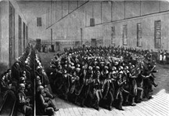
Growth Of A Movement
1805 Trouble With The Shakers Movement, McNemar & Dunlavy Defect
Thompson & Marshall Return To Presbyterianism
His 1st wife, Eliza Passes Away
Even With Setbacks, The Movement Grows Rapidly
The Shakers In Kentucky

Slide 16
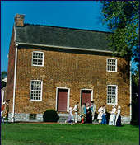
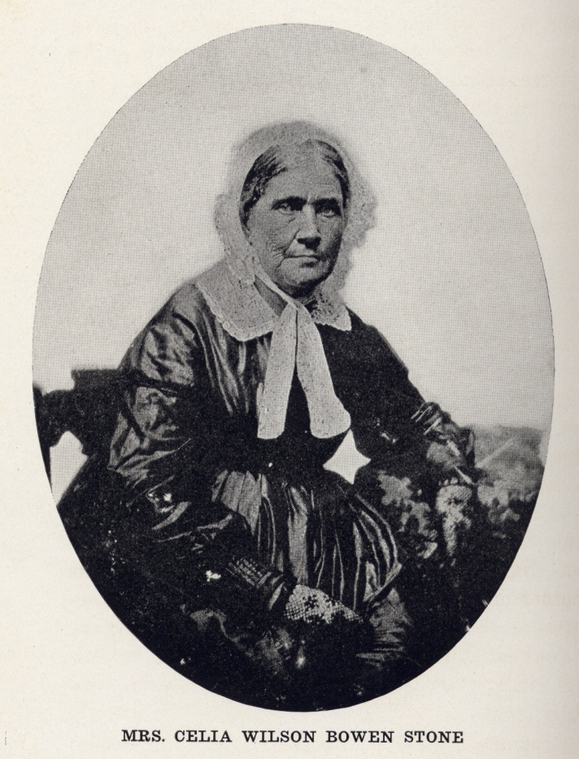
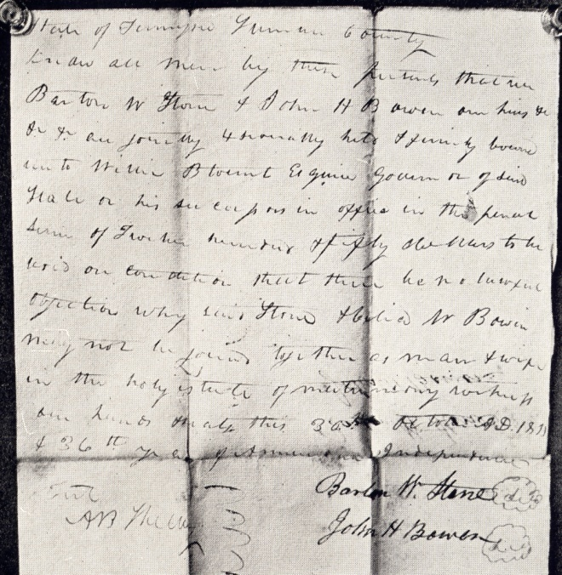
While At Gallatin, Tennessee
Married Celia Bowen October 31, 1811
Bowen Home
Mansker’s Station, Tennessee
Copy Of Marriage Bond, Gallatin, Tennessee

Slide 17
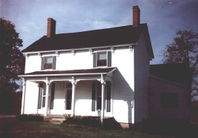
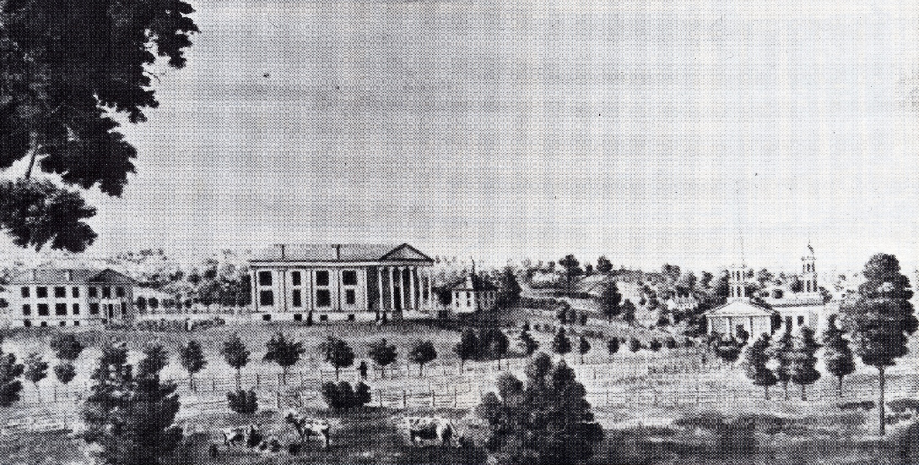
Stone At Rittenhouse Academy
1816 Stone Was Invited To Come And Be Headmaster
He continued until 1819
Note: In 1829 It Became Absorbed Into The Georgetown College (Baptist) – Continues To This Day
Stone Home In Georgetown

Slide 18
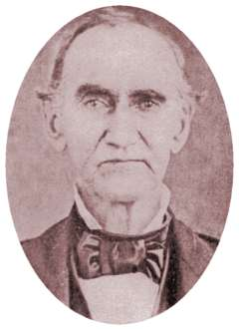
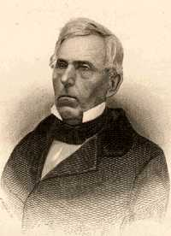
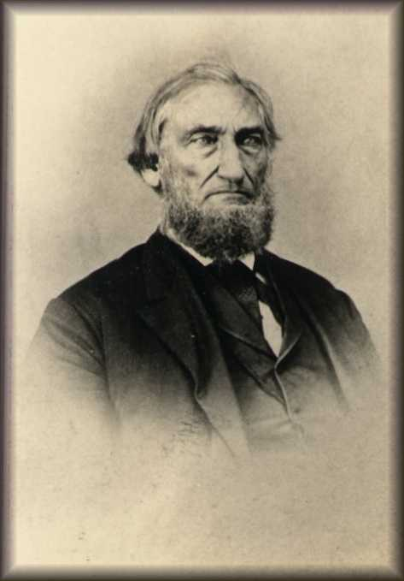
Stone’s Influence
Influenced Many Greats Of The Rest. Movement
  James Matthews
  B.F. Hall
  John T. Johnson
  Tolbert Fanning
  And Many Others
John T. Johnson
Tolbert Fanning
B.F. Hall

Slide 19
1824 — First Meeting Of Stone & Alexander Campbell

Slide 20
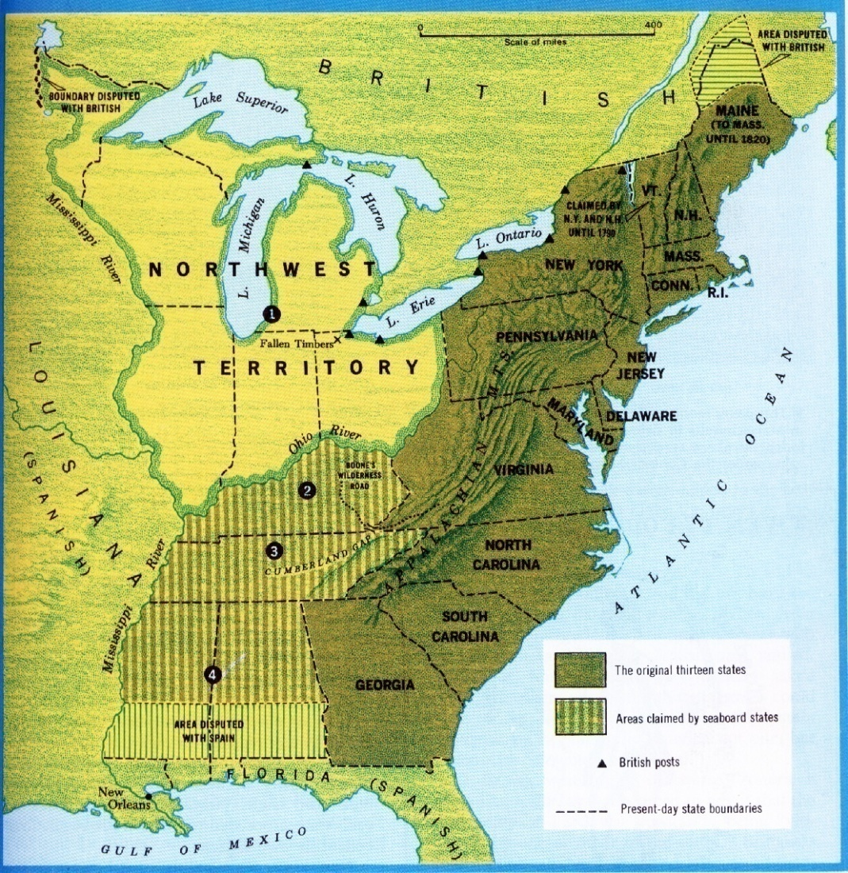
The Influence Of Thomas & Alexander Campbell
1809, Thomas & Alexander Campbell, Bethany, Virginia

Slide 21
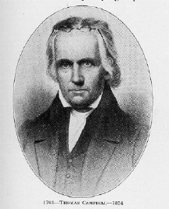
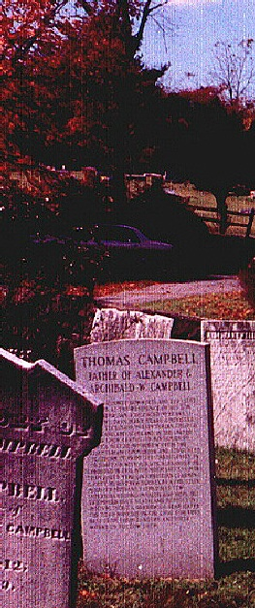
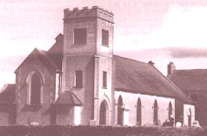
Thomas
Campbell
1763 - 1854
The Presbyterian Church in Ahorey,
Northern Ireland where Thomas
Campbell preached before
moving to the United States.
The bell tower is not original.
Thomas Campbell born February 1, 1763 in Newry, County Down, Ireland. Arrived here May 13, 1807. A Presbyterian preacher who through study of the Bible saw the need to preach it and live wholly under its authority. Now buried at God’s Acre, Bethany, West Virginia next to his son, Alexander.
Notes:
At the age of 44, Thomas began having severe health problems that doctors determined was the result of the harsh weather in Ireland. It was suggested that he needed to go to America to get some relief.
T. Campbell was a believer in the unity of believers. Had even tried to help unite the splintering sects of his own Presbyterian denomination by travelling to Glasgow, Scotland to help unite fractioning bodies, but failed.

Slide 22
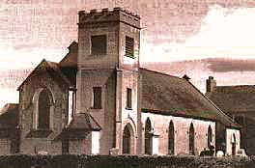
Alexander Campbell Is Born In Ballymena, County Antrim, Ireland, September 12, 1788
Receives A Classical Education From His Father
1807 Teaches School Takes Charge Of His Father's School At Rich Hill, Ireland, His Father Departs For America
1808 Prepares To Depart To America To Join Thomas Campbell
Presbyterian Church In Ahory, North Ireland Where Thomas Campbell Preached

Slide 23
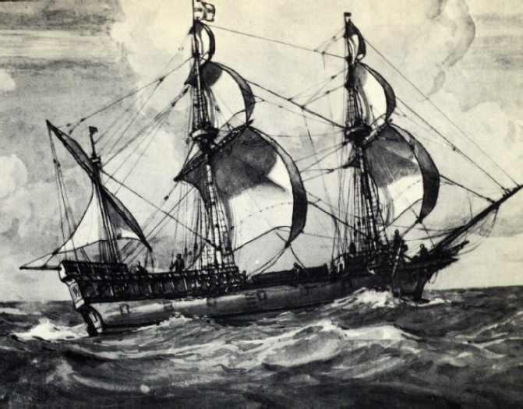
Campbell To Glasgow
Departed For America September 28, 1808 On The Sailing-Vessel Hibernia
Ship-Wreck Off Scotland Coast October 7, 1807

Slide 24
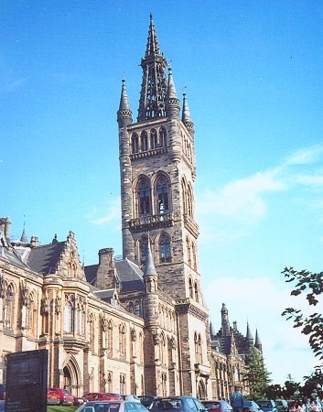
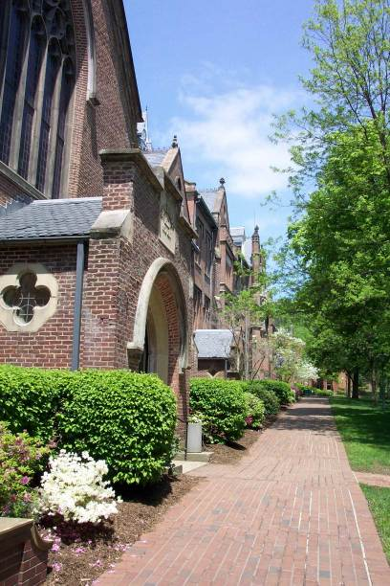
November 9, 1808 Campbell Attends Glasgow University, Scotland
Note Later Resemblance To Bethany College

Slide 25
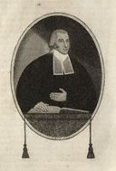
Influences Of Greville Ewing
1767-1841- Born In Edinburgh, Scotland
Taught In Haldane Schools Until 1808
Began Teaching At Glasgow University, One Of His Students: A. Campbell
Campbell’s Essays On Leadership & Lord’s Supper Caused Him To Give Up Presbyterianism

Slide 26
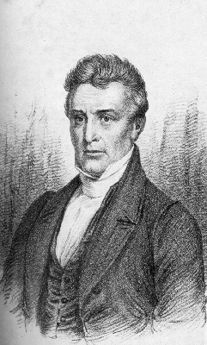
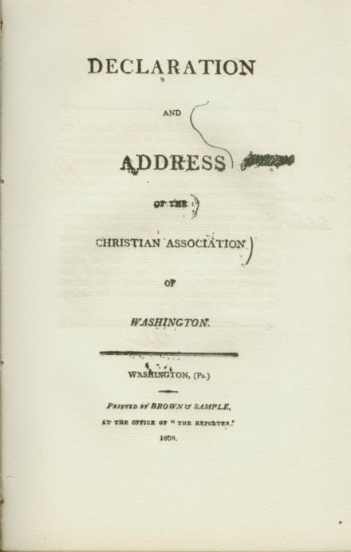
October, 1809 Reaches
Washington, Pennsylvania
Reads Proof-Sheets Of The "Declaration And Address"
Devotes His Life To The Plea For Christian Union. "Declaration And Address" Published
1810 Preaches First Sermon, July 15, From Matthew 7: 24-27

Slide 27
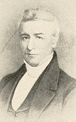
March 12, 1811 Marries Margaret Brown.
May 4, 1811, Christian Association Of Washington Becomes Church At Brush Run
Began To Celebrate The Lord's Supper weekly
June 16, 1st Meeting In New Brush Run Building
1812, Jan. 1st — Ordained To The Work Of The Ministry
1812, March 13th — His Daughter Jane Born
1811, Age 23

Slide 28
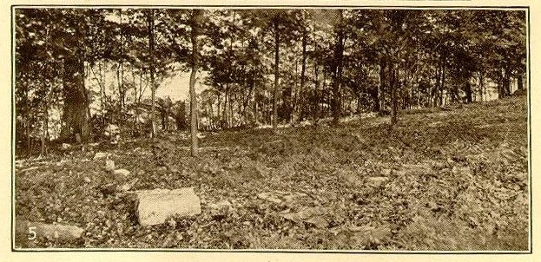
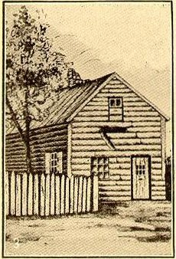


Brush Run 1811-1823

Slide 29

Begins A New Study
Of The Subject Of Baptism
June 12, 1812 Immersed By Elder Matthias Luce, Of The Baptist Church, On The Confession Of Faith In Christ As The Son Of God.
Thomas Campbell, Concedes To Him The Leadership Of The Movement At Age 24
Matthias Luce

Slide 30

1816 Sermon On The Law
Brush Run Joins Redstone Association of Washington
August 30, 1816 – Cross Creek Baptist Church – Elder Pritchard, preacher there.
Another preacher was appointed to preach, but could not as he was sick. Campbell volunteered
Later referred to the message as “rather extemporaneous”
Alexander Campbell Preaches The "Sermon on The Law”
Sermon Content – Rightly Dividing Truth
It Marks The Beginning Of The Separation From The Baptists

Slide 31

The Power Of The Printed Page
1823, July 4, A.C. Begins Publishing A Monthly Journal Called
The Christian Baptist

Slide 32

Preparation For: Campbell/McCalla Debate Of 1823
William L. McCalla, Presbyterian
  According To Campbell, McCalla Was “Smoke In Their Eyes And A Thorn In Their Sides” Among The Baptist Community
October 15-21, 1823 In Washington, Mason Cty. Kentucky
Subject: Christian Baptism
Preparation Was A Joint Effort With Thomas Campbell & Walter Scott
Alexander Campbell Prints The Debate

Slide 33

Influence Of The Campbell/McCalla
Debate Of 1823
Buried At VanAlstyne, TX
His Stone Says:
He Was Ordained To The
Ministry, May 1st, 1828
And Was The 1st In Ky.
To Preach Salvation
Through Obedience To
The Gospel.
B.F. Hall
In The Discussion Campbell Argued That Baptism Was For The Remission Of Sin
Spring of 1826, B.F. Hall Found A Copy Of The Debate And Read It
  In His Preaching Many Had Come To The Mourner’s Bench And Found No Relief
  When Reading The Debate, He Noted Campbell’s Teaching On Baptism For Remission Of Sins, At Which Point, He Raised His Hands And Said, “Eureka! Eureka! I Found It! I Found It!
With This Discovery The Purpose Of Baptism Quickly Spread Throughout The Church

Slide 34

1824 — Campbell Visits Georgetown, Ky Meeting Stone & Raccoon John Smith
A. Campbell
Raccoon John Smith
B.W. Stone

Slide 35

The Christian Messenger
The Christian Messenger Ran From 1826-1844
John T. Johnson Helped Produce It
Kept The Brotherhood Connected
B.W. Stone
John T. Johnson

Slide 36

1830
January 4, Millennial Harbinger Begins
July 5, Last Issue Of The Christian Baptist

Slide 37


Coming Together Of A Movement
Meeting Of Stone’s Christians & Campbell’s Disciples At Hill Street Church In Lexington, Last Week In 1831
January 1, 1832 Joined Forces With A. Campbell’s Disciples Movement
“Let us, then my brethren, be no longer Campbellites or Stoneites, New Lights or Old Lights, or any other kind of lights, but let us come to the Bible, and to the Bible alone, as the only book in the world that can give us all the light we need.” — John Smith
Hill Street Church, Lexington, Kentucky
“Raccoon”
John Smith

Slide 38


The Good New Spreads
John T. Johnson

Slide 39

1834 Stone Moves To Jacksonville, Illinois
1835 Campbell produces a songbook
Barton W. Stone’s Name Is Added To The List Of Editors To Help Increase Unity In The Movement

Slide 40




Bacon College 1836
Walter Scott
T.F. Johnson

Slide 41


1839 Plans For Bethany College.
1840 Bethany College Chartered And Organized, Campbell Elected President
Donated Land Plus $10,000.00

Slide 42
Last Years Of The Life
Of B.W. Stone
Campbell Influence Begins Overshadowing Stone’s
1834 Stone Moves To Jacksonville, Illinois
1841 Stone Suffers A Stroke But Improves
1843 Write His Autobiography

Slide 43


Cane Ridge Cemetery
The Church of Christ
at Caneridge & other
generous friends in Kentucky
have caused this monument
to be erected as a tribute of
affection & gratitude to
BARTON W. STONE
Minister of the gospel of
Christ and the distinguished
reformer of the 19 Century.
BORN Dec. 21, 1772
DIED Nov. 9, 1844
His remains lie here.
This monument was erected in 1847

Slide 44


Campbell’s Visit
Campbell’s Reaction Upon His Visit To The Grave Of Barton W. Stone

Slide 45





Around Cane Ridge

Slide 46

Grave Of William Rogers
William Rogers
BORN IN
Campbell Co. VA
July 7, 1784. Removed With His Father To Caine Ridge Bourbon Co.
Apr, 1798
United With The
Church Of Christ
At Cane Ridge
In 1807
DIED Feb. 15, 1862.
In The 78 Year Of His Age.
He was the friend of God

Slide 47



1843 Campbell-Rice Debate, Campbell's Last Public Debate Lasted Sixteen Days
1843 – 55 Years Old

Slide 48


1847 Alexander Campbell Tours Through England, Scotland And Ireland
Illegally Arrested
Gravely Ill
During His Absence His Son Wickliffe Had Drowned, Not Informed Until His Return Home
Invited To Speak Before Congress.

Slide 49

Rare Picture Of Campbell & Children
L2R Willie, Virginia, A.C. & Decima, c.1849

Slide 50


1849 National Convention Meets In Cincinnati, Organizes The American Christian Missionary Society

Slide 51





1852 — Bethany
Church Of Christ

Slide 52



1854
Thomas Campbell
Died January 4 At Age Of
Eighty-Three
The Last Picture Taken Of Thomas Campbell

Slide 53

1856 A. Campbell Visits, St. Catharine's Springs, Canada With His Wife And Daughter Decima & Made Another Tour Through Virginia
1857 Tour Through South For Endowment Funds
School Building At Bethany Burned
1858 Campbell, Nearly Seventy Years Old, Started Resolutely To Secure Funds To Restore The College

Slide 54

1860 "Lectures and Addresses" Published
Campbell Publishes "Life of Thomas Campbell"
Addition Of Instrument At Midway, Kentucky
Millennial Harbinger, 1851, 582.
Notes:
Desideratum – noun - something desired as a necessity; "the desiderata for a vacation are time and money"

Slide 55
Campbell’s Declining Health
November, 1865, Campbell's Last Article In The Millennial Harbinger Is Published
1866 He Is Confined To The House By A Heavy Cold
Assisted In Ordaining Elders At The Church At Bethany
February 25 He Was Confined To His Bed, And Never Arose From It

Slide 56

March 4
At 11:45 P.M
Campbell Finishes His Course
His Selina Comforted Him With "The Blessed Savior Will Go With You Through The Valley Of The Shadow Of Death." He replied: "That He Will! That He Will!" These Were His Last Words.

Slide 57

Chair Where Campbell Studied
For Five Summers After Campbell Died, Selina Campbell Had His Study Chair Placed In The Cemetery At The Grave Where Students And Other Visitors To The Grave Could Sit And Contemplate The Life Of This Great Champion

Slide 58

God’s Acre

Slide 59

Buried Among His Parents,
Wives & Children
In Memoriam
Alexander Campbell
Defender Of The Faith
Once Delivered To The Saints
Founder Of
Bethany College
Who Being Dead Yet Speaketh By His Numerous
Writing And Holy Example
Born In County Of
Antrim, Ireland
Sept. 12, 1788
Died At Bethany, Va
March 4, 1866

